Slide 1
2 October 2024
Videos and books to enjoy
Part of ‘The class as a theatrical play’
Lucas F M da Silva

Slide 2
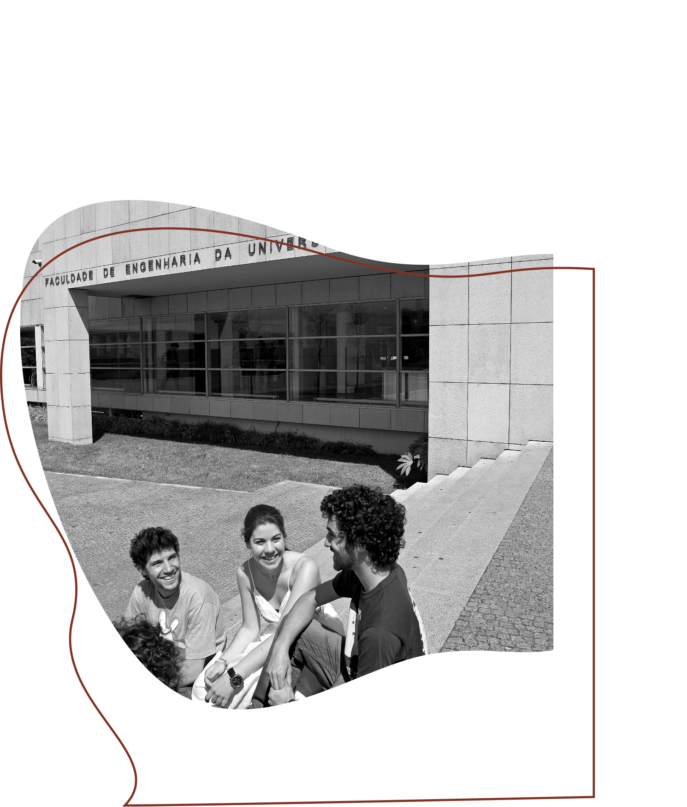
Panel
The class as a theatrical play
Courses
Videos
Books
Discussion
Lucas F M da Silva
Videos and books to enjoy

Slide 3
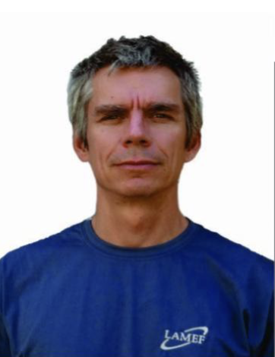
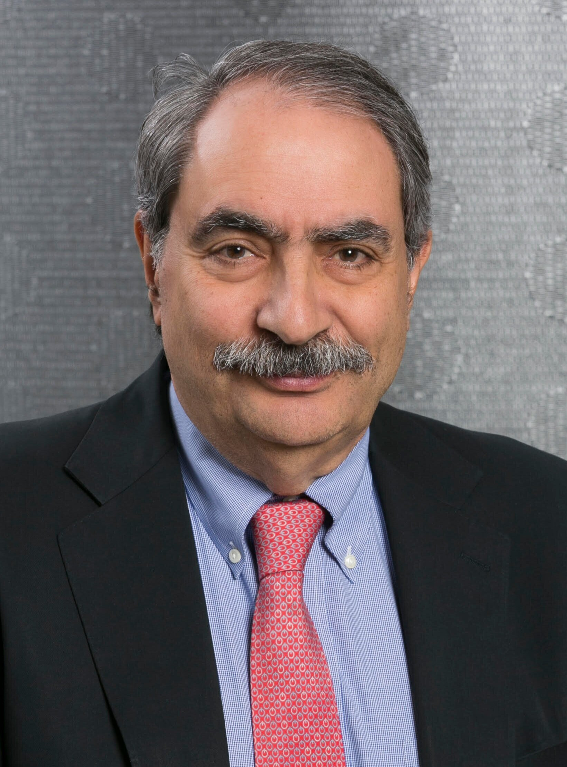
Panel
Ana Paula Rocha
Pedagogy, FEUP
Luis Miguel Costa
Library, FEUP
Alcibíades Paulo Guedes
INEGI
Afonso Reguly
Universidade Federal do Rio Grande do Sul
Holger Fricke
Fraunhofer IFAM
Nuno Santiago
Audiovisual
Felix Bloeck
Wiley
César Santos
Publindústria
Paulo Tavares de Castro
FEUP
Costis Toregas
Washington University
David Zeichick
California State University, Chico
Michael Qaissaunee Brookdale Community College, NJ
Lucas F M da Silva
Videos and books to enjoy

Slide 4
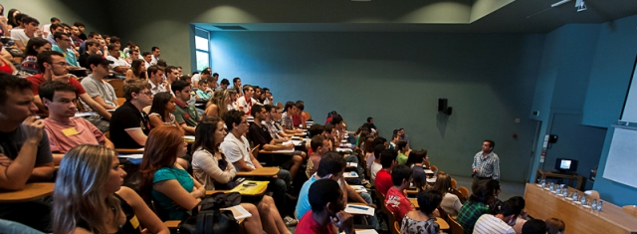
The class as a theatrical play
1. Introduction
Theatre
Convey a story
Teaching
Convey knowledge
Lucas F M da Silva
Videos and books to enjoy

Slide 5
The class as a theatrical play
1. Introduction
Our aim: Combine both approaches and bring theatre to the classroom
Tell a well structured, captivating story and ensure that its level of attention is maintained through better timing, demonstrations and props
The challenge: How to so in an effective and systematic manner?
Lucas F M da Silva
Videos and books to enjoy

Slide 6
“
“A lesson should be prepared like a choreography.”
Raimundo Delgado (1950-2019)

Slide 7
The class as a theatrical play
2. Methodology
1. Analyse the knowledge that should be conveyed to the students and modify the classes to improve communication
2. Create support material and demos to enrich the classes
Lucas F M da Silva
Videos and books to enjoy

Slide 8
“
“Once you can explain an idea in a simple language you have deeply understood it.”
Richard Feynman (1918-1988)

Slide 9
The class as a theatrical play
3. Implementation – Communication
Before
Theoretical–practical classes
Practical classes
Live classes
Heavy reference books
Exercise solving
Lucas F M da Silva
Videos and books to enjoy

Slide 10
The class as a theatrical play
3. Implementation – Communication
After
Theoretical–practical classes
Practical classes
Live classes
Heavy reference books
Pre-recorded classes
Demos
Master classes
Simpler and more digested books
Exercise solving
Laboratorial activities
Practical books
Lucas F M da Silva
Videos and books to enjoy

Slide 11
The class as a theatrical play
3. Implementation – Support material
Pre-recorded classes
Example of a pre-recorded class
Easily accessible resource for conveying the “knowledge heavy” portions of syllabus
Free the live classes from the pressure of delivering all this information
Lucas F M da Silva
Videos and books to enjoy

Slide 12
The class as a theatrical play
3. Implementation – Support material
Laboratorial demos and props
Example of a laboratorial demo
Allow for hands-on learning with easy to understand examples
Well-thought laboratorial demonstrations permit the quick memorization of key principles and findings
Lucas F M da Silva
Videos and books to enjoy

Slide 13
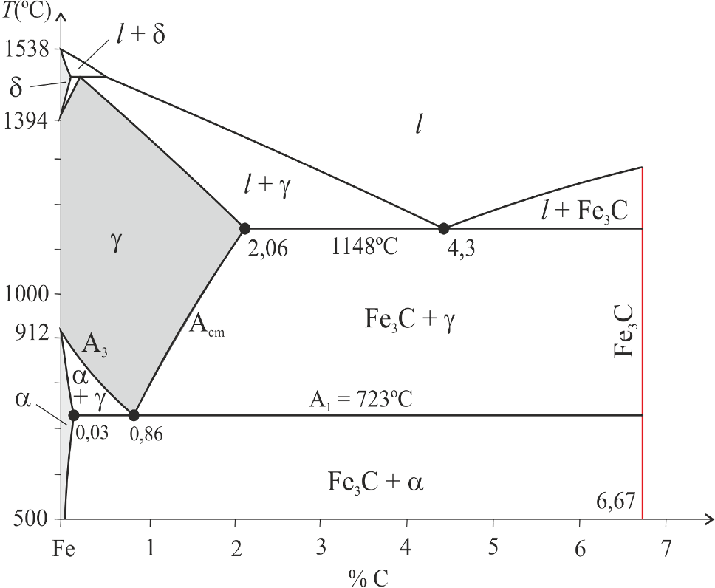
Courses
1. Courses on material science
Target course: Materials
Bachelor in Management and Industrial Engineering
1st year – 2nd semester
Basic knowledge about science & engineering materials in 56h course:
– 28h theory,
– 12h pen & paper exercises,
– 12h laboratory experiments,
– 4h visit industry.
Presentation of concepts & basic information, use of props in class, laboratory demonstrations, master classes from industry (Honda, Celoplás & Nelo) & visits to industry (Ramada).
Support material: videos of circa 10 min (in YouTube) & books closely related to the contents and well digested.
Lucas F M da Silva
Videos and books to enjoy

Slide 14
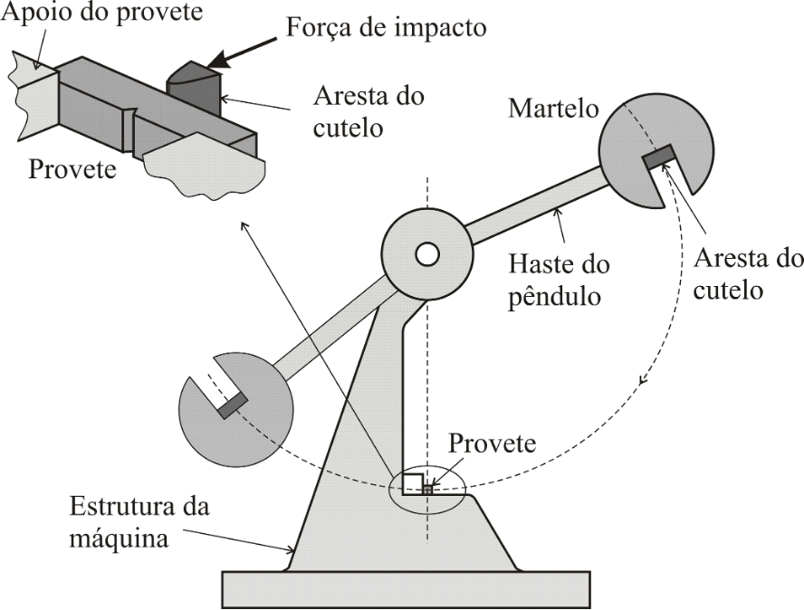
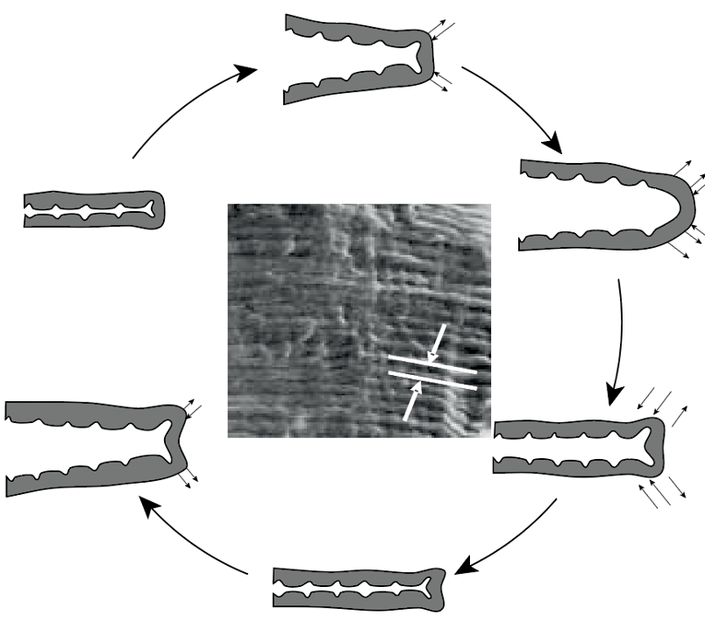
Courses
1. Courses on material science
Target course: Materials Science & Engineering
Bachelor in Aerospace Engineering
1st year – 1st semester
Basic knowledge about science & engineering materials in 49h course:
– 28h theory,
– 10h pen & paper exercises,
– 8h laboratory experiments,
– 3h visit industry.
Presentation of concepts & basic information, use of props in class, laboratory demonstrations, master classes from industry (Embraer & Airbus) & visits to industry (Airbus).
Support material: videos of circa 10 min (in YouTube) & books closely related to the contents and well digested.
Lucas F M da Silva
Videos and books to enjoy

Slide 15
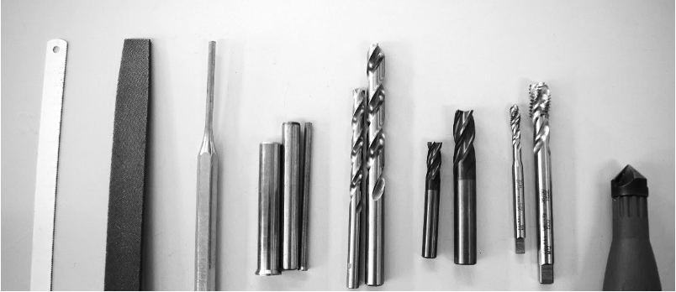
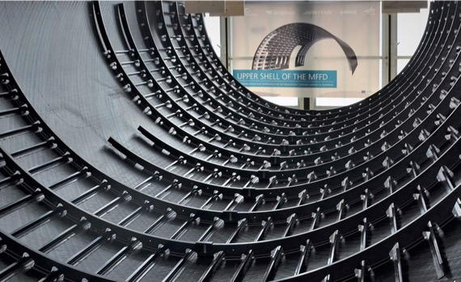
Courses
1. Courses on material science
Target courses:
– Materials,
– Materials Science & Engineering.
Assessment through reports, pen and paper exams & multiple-choice questions.
Contents cover:
– Structure of materials,
– Phase diagrams,
– Plastic deformation,
– Strengthening mechanisms,
– Fracture mechanics,
– Fatigue & Creep,
– Metals,
– Ceramics,
– Polymers,
– Composites.
Lucas F M da Silva
Videos and books to enjoy

Slide 16
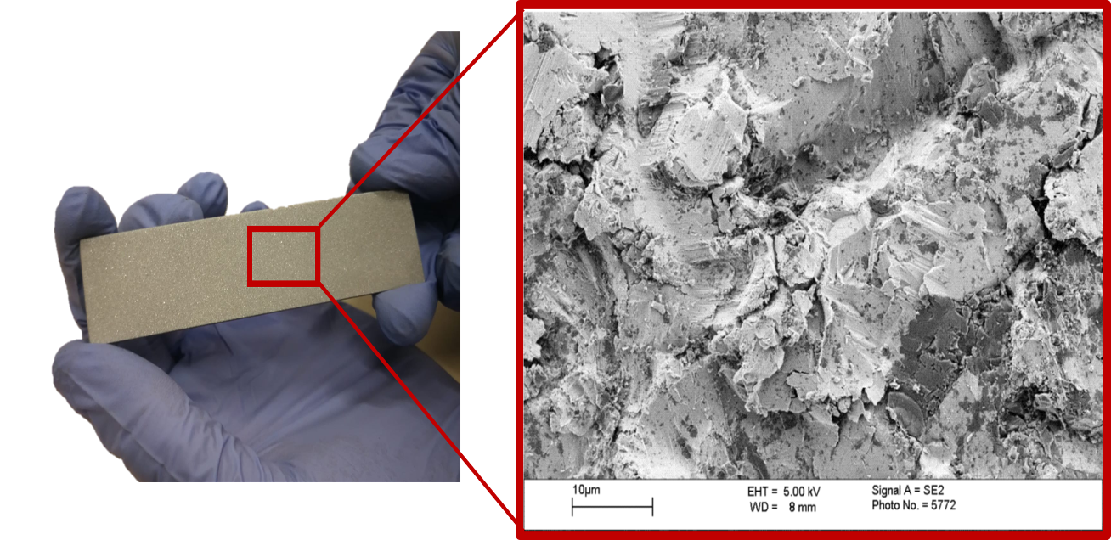
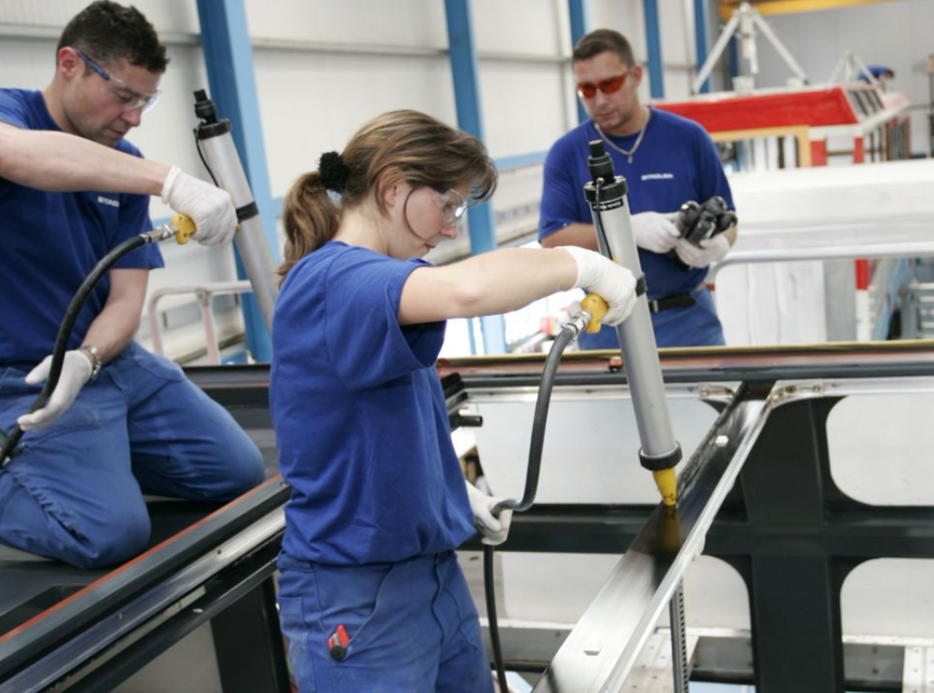
Courses
2. Courses on adhesive joining
Target course: Manufacturing Processes I
Bachelor in Mechanical Engineering
3rd year – 1st semester
Basic knowledge about adhesive bonding in 8h course:
– 4h theory,
– 2h computational laboratory,
– 2h laboratory experiments.
Presentation of concepts & basic information, use of props in class & laboratory demonstrations.
Support material: videos of circa 10 min (in YouTube) & books closely related to the contents and well digested.
Lucas F M da Silva
Videos and books to enjoy

Slide 17
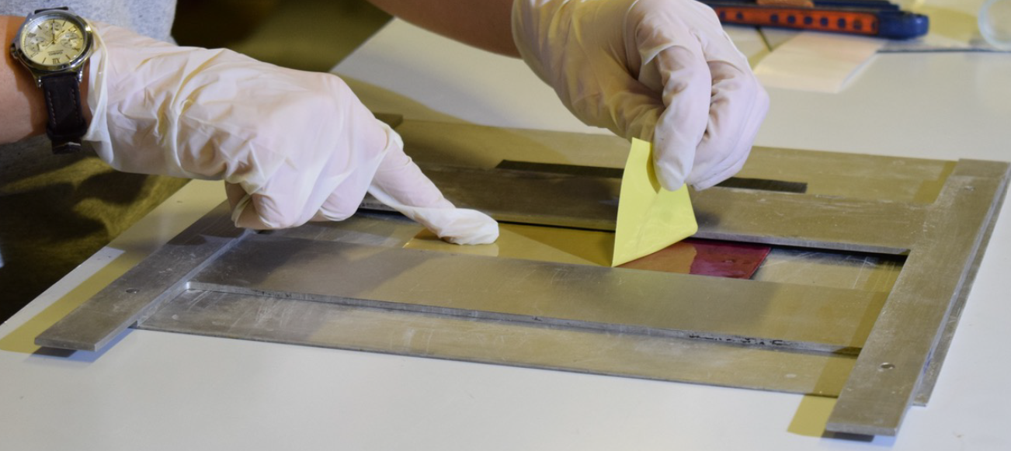
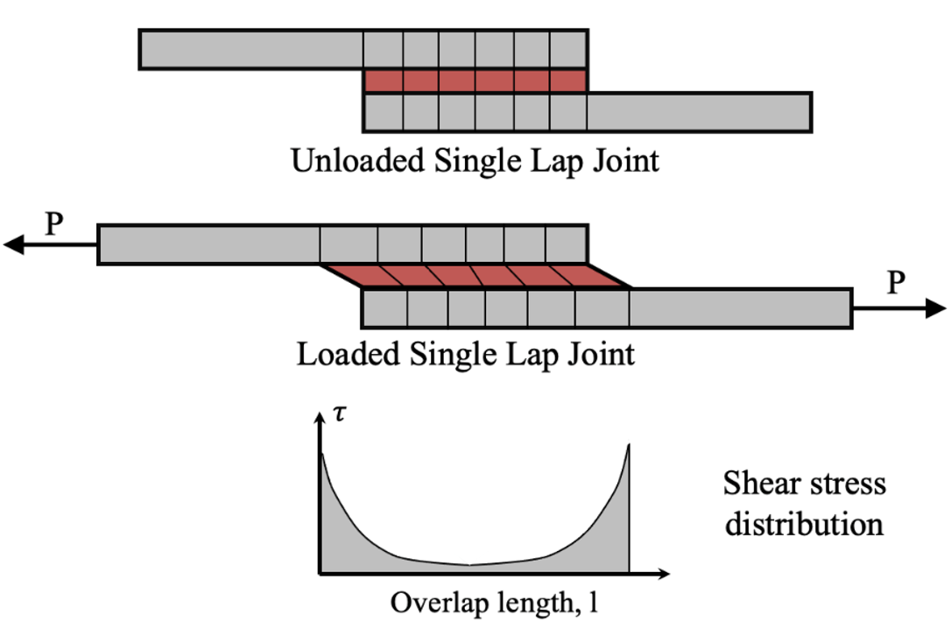
Courses
2. Courses on adhesive joining
Target course: Aircraft Structural Materials & Joints
Master in Mechanical Engineering (Aeronautics & Vehicle Struct.)
1st year – 2nd semester
Basic knowledge about adhesive bonding in 6h course:
– 6h theory,
– 1.5h laboratory experiments,
– 1.5h computational laboratory.
Presentation of concepts & basic information, use of props in class & laboratory demonstrations.
Support material: videos of circa 10 min (in YouTube) & books closely related to the contents and well digested.
Lucas F M da Silva
Videos and books to enjoy

Slide 18
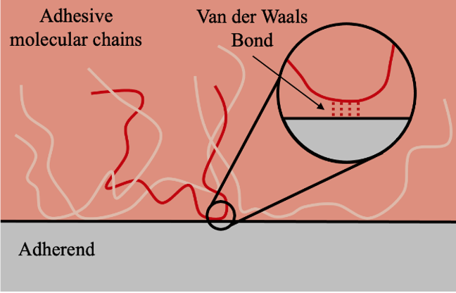
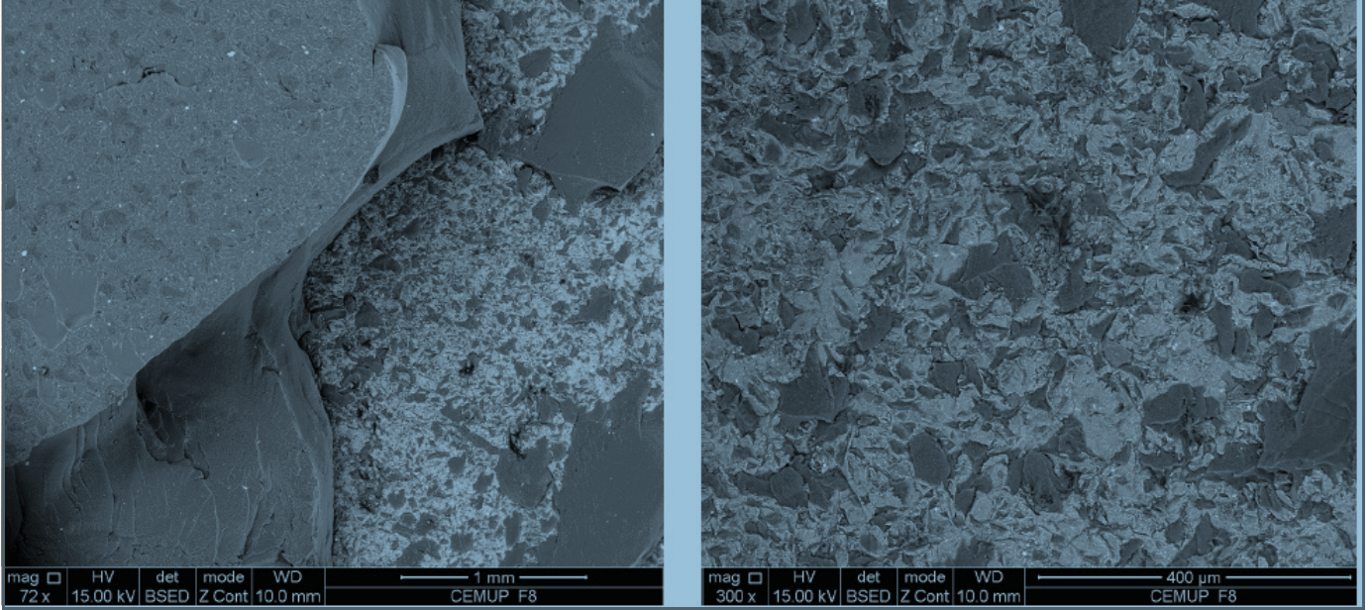
Courses
2. Courses on adhesive joining
Target course: Advanced Joining Processes
Master in Mechanical Engineering (Materials & Processes)
1st year – 1st semester
Basic knowledge about adhesive bonding in 18h course:
– 12h theory,
– 3h visit industry,
– 3h laboratory experiments,
– 2h computational laboratory.
Presentation of concepts & basic information, use of props in class, laboratory demonstrations & visits to industry (Autoeuropa – Wolkswagen).
Support material: videos of circa 10 min (in YouTube) & books closely related to the contents and well digested.
Lucas F M da Silva
Videos and books to enjoy

Slide 19
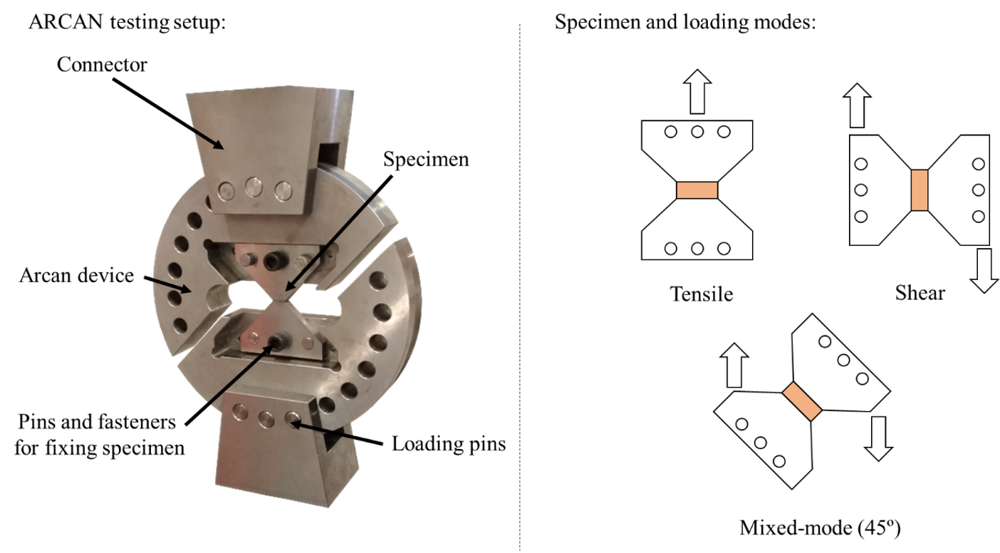
Courses
2. Courses on adhesive joining
Target courses:
– Manufacturing Processes I,
– Aircraft Structural Materials & Joints,
– Advanced Joining Processes.
Assessment through reports & multiple-choice questions.
Contents cover:
– Introduction,
– Theory of adhesion,
– Surface preparation,
– Adhesive families,
– Adhesive characterization,
– Manufacture,
– Quality Control,
– Health & Safety,
– Joint design,
– Durability.
Lucas F M da Silva
Videos and books to enjoy

Slide 20
Courses
3. FEUP and INEGI management perspective
Abílio de Jesus
Bachelor in Mechanical Engineering
Albertino Arteiro
Bachelor in Aerospace Engineering
Vera Miguéis
Bachelor in Industrial and Management Engineering
Marco Parente
Master in Mechanical Engineering
João Manuel Tavares
Department of Mechanical Engineering
José Fernando Oliveira
Department of Industrial and Management Engineering
Ana Paula Rocha
Pedagogy, FEUP
Luis Miguel Costa
Library, FEUP
Alcibíades Paulo Guedes
INEGI
Lucas F M da Silva
Videos and books to enjoy

Slide 21
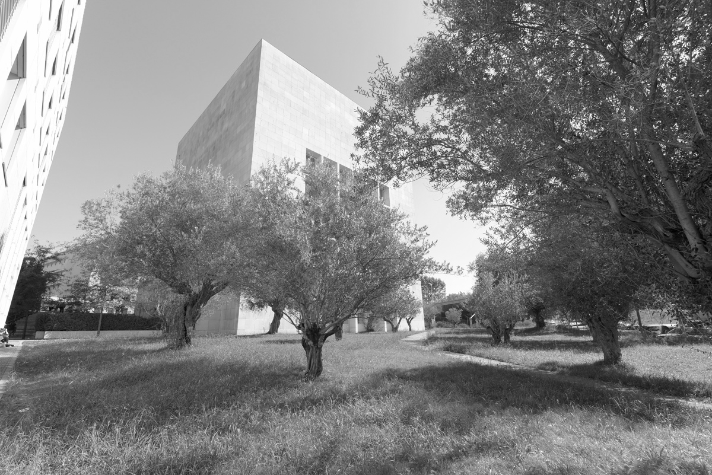
Courses
4. Materials specialist perspective
Afonso Reguly
Universidade Federal do Rio Grande do Sul
Lucas F M da Silva
Videos and books to enjoy

Slide 22
Courses
5. Adhesive bonding specialist perspective
Holger Fricker
Fraunhofer IFAM
Lucas F M da Silva
Videos and books to enjoy

Slide 23
Videos
1. Courses on material science
Target course: Materials & Materials Science & Engineering
1st year of Bachelor in Aerospace Engineering & 1st year of Bachelor in Management and Industrial Engineering
84 video modules
Example of a support video: Crystalline structures prop
Materiais da Licenciatura em Engenharia e Gestão Industrial
Ciência dos Materiais da Licenciatura em Engenharia Aeroespacial
Vídeos
Materiais (84 módulos)
Lucas F M da Silva
Videos and books to enjoy

Slide 24
Videos
1. Courses on material science
Target course: Materials & Materials Science & Engineering
1st year of Bachelor in Aerospace Engineering & 1st year of Bachelor in Management and Industrial Engineering
84 video modules
Example of a support video: Calculations in phase diagrams
Materiais da Licenciatura em Engenharia e Gestão Industrial
Ciência dos Materiais da Licenciatura em Engenharia Aeroespacial
Vídeos
Materiais (84 módulos)
Lucas F M da Silva
Videos and books to enjoy

Slide 25
Videos
1. Courses on material science
Target course: Materials & Materials Science & Engineering
1st year of Bachelor in Aerospace Engineering & 1st year of Bachelor in Management and Industrial Engineering
84 video modules
Example of a support video: Necking during tensile testing
Materiais da Licenciatura em Engenharia e Gestão Industrial
Ciência dos Materiais da Licenciatura em Engenharia Aeroespacial
Vídeos
Materiais (84 módulos)
Lucas F M da Silva
Videos and books to enjoy

Slide 26
Videos
1. Courses on material science
Target course: Materials & Materials Science & Engineering
1st year of Bachelor in Aerospace Engineering & 1st year of Bachelor in Management and Industrial Engineering
84 video modules
Example of a support video: Visit to AIRBUS
Materiais da Licenciatura em Engenharia e Gestão Industrial
Ciência dos Materiais da Licenciatura em Engenharia Aeroespacial
Vídeos
Materiais (84 módulos)
Lucas F M da Silva
Videos and books to enjoy

Slide 27
Videos
1. Courses on material science
Target course: Materials & Materials Science & Engineering
1st year of Bachelor in Aerospace Engineering & 1st year of Bachelor in Management and Industrial Engineering
84 video modules
Example of a support video: Glass type demo
Materiais da Licenciatura em Engenharia e Gestão Industrial
Ciência dos Materiais da Licenciatura em Engenharia Aeroespacial
Vídeos
Materiais (84 módulos)
Lucas F M da Silva
Videos and books to enjoy

Slide 28
Videos
1. Courses on material science
Target course: Materials & Materials Science & Engineering
1st year of Bachelor in Aerospace Engineering & 1st year of Bachelor in Management and Industrial Engineering
84 video modules
Example of a support video: Visit to NELO
Materiais da Licenciatura em Engenharia e Gestão Industrial
Ciência dos Materiais da Licenciatura em Engenharia Aeroespacial
Vídeos
Materiais (84 módulos)
Lucas F M da Silva
Videos and books to enjoy

Slide 29
Videos
1. Courses on material science
Target course: Materials & Materials Science & Engineering
1st year of Bachelor in Aerospace Engineering & 1st year of Bachelor in Management and Industrial Engineering
84 video modules
Example of a support video: INEGI demo
Materiais da Licenciatura em Engenharia e Gestão Industrial
Ciência dos Materiais da Licenciatura em Engenharia Aeroespacial
Vídeos
Materiais (84 módulos)
Lucas F M da Silva
Videos and books to enjoy

Slide 30
Videos
2. Courses on adhesive joining
Target course: Manufacturing Processes I
3rd year of the Bachelor in Mechanical Engineering
13 video modules
Example of a support video: Adhesive tape prop
Materiais da Licenciatura em Engenharia e Gestão Industrial
Ciência dos Materiais da Licenciatura em Engenharia Aeroespacial
Vídeos
Materiais (84 módulos)
Lucas F M da Silva
Videos and books to enjoy

Slide 31
Videos
2. Courses on adhesive joining
Target course: Manufacturing Processes I
3rd year of the Bachelor in Mechanical Engineering
13 video modules
Example of a support : Elastic deformation of a joint demo
Materiais da Licenciatura em Engenharia e Gestão Industrial
Ciência dos Materiais da Licenciatura em Engenharia Aeroespacial
Vídeos
Materiais (84 módulos)
Lucas F M da Silva
Videos and books to enjoy

Slide 32
Videos
2. Courses on adhesive joining
Target course: Aircraft Structural Materials & Joints
Master in Mechanical Engineering (Aeronautics & Vehicle Struct.)
13 video modules
Example of a support video: Honeycomb structure prop
Materiais da Licenciatura em Engenharia e Gestão Industrial
Ciência dos Materiais da Licenciatura em Engenharia Aeroespacial
Vídeos
Materiais (84 módulos)
Lucas F M da Silva
Videos and books to enjoy

Slide 33
Videos
2. Courses on adhesive joining
Target course: Aircraft Structural Materials & Joints
Master in Mechanical Engineering (Aeronautics & Vehicle Struct.)
13 video modules
Example of a support video: Numerical modelling demo
Materiais da Licenciatura em Engenharia e Gestão Industrial
Ciência dos Materiais da Licenciatura em Engenharia Aeroespacial
Vídeos
Materiais (84 módulos)
Lucas F M da Silva
Videos and books to enjoy

Slide 34
Videos
2. Courses on adhesive joining
Target course: Advanced Joining Processes
1st year of Master in Mechanical Engineering (Materials & Processes)
32 video modules
Example of a support video: Water droplets and contact angle prop
Materiais da Licenciatura em Engenharia e Gestão Industrial
Ciência dos Materiais da Licenciatura em Engenharia Aeroespacial
Vídeos
Materiais (84 módulos)
Lucas F M da Silva
Videos and books to enjoy

Slide 35
Videos
2. Courses on adhesive joining
Target course: Advanced Joining Processes
1st year of Master in Mechanical Engineering (Materials & Processes)
32 video modules
Example of a support video: Peel test demo
Materiais da Licenciatura em Engenharia e Gestão Industrial
Ciência dos Materiais da Licenciatura em Engenharia Aeroespacial
Vídeos
Materiais (84 módulos)
Lucas F M da Silva
Videos and books to enjoy

Slide 36
Videos
2. Courses on adhesive joining
Target course: Advanced Joining Processes
1st year of Master in Mechanical Engineering (Materials & Processes)
32 video modules
Example of a support video: Jointdesigner software demo
Materiais da Licenciatura em Engenharia e Gestão Industrial
Ciência dos Materiais da Licenciatura em Engenharia Aeroespacial
Vídeos
Materiais (84 módulos)
Lucas F M da Silva
Videos and books to enjoy

Slide 37
Videos
3. Audiovisual specialist perspective
Nuno Santiago
Audiovisual
Lucas F M da Silva
Videos and books to enjoy

Slide 38
Books
1. Books for courses on material science
Materials & Materials Science & Engineering
1st year of Bachelor in Aerospace Engineering & 1st year of Bachelor in Management and Industrial Engineering
Lucas F M da Silva
Videos and books to enjoy

Slide 39
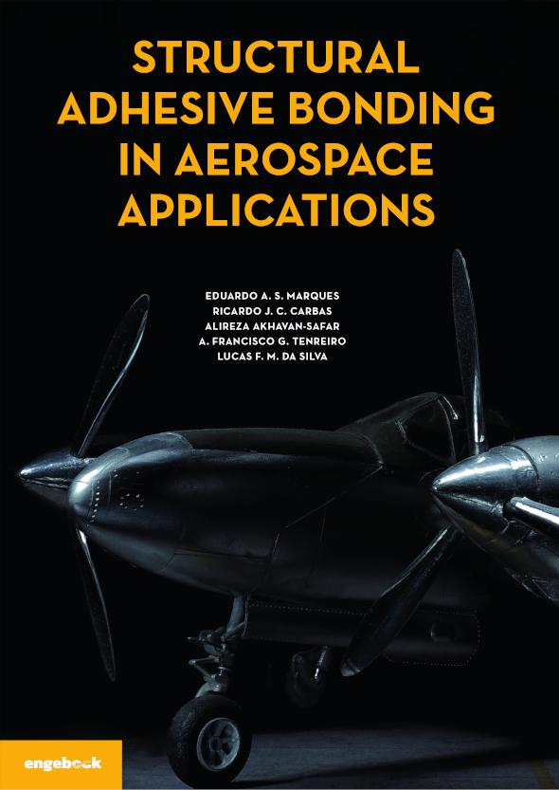
Books
2. Books for courses on adhesive joining
Manufacturing Processes I
Aircraft Structural
Materials & Joints
3rd year of Bachelor in Mechanical Engineering
1st year of Master in Mechanical Engineering
Lucas F M da Silva
Videos and books to enjoy

Slide 40
Books
2. Books for courses on adhesive joining
Advanced Joining Processes
1st year of Master in Mechanical Engineering
Lucas F M da Silva
Videos and books to enjoy

Slide 41
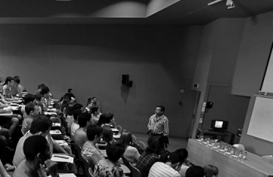
Books
3. Publishers perspective
Felix Bloeck
Wiley
César Santos
Publindústria
Lucas F M da Silva
Videos and books to enjoy

Slide 42
Discussion
Teaching at FEUP (past and present)
Paulo Tavares de Castro
FEUP
Lucas F M da Silva
Videos and books to enjoy

Slide 43
Discussion
How to make the most of new technologies in teaching?
What’s the risks involved?
Costis Toregas
Washington University
David Zeichick
California State University, Chico
Michael Qaissaunee Brookdale Community College, NJ
Lucas F M da Silva
Videos and books to enjoy

