Slide 1
The class as a theatrical play
E. A. S. Marques¹, R.J.C. Carbas¹, F. C. Sousa¹, P. P. Camanho², Lucas F. M. da Silva²
¹Institute of Science and Innovation in Mechanical and Industrial Engineering (INEGI), Porto, Portugal
²Departamento de Engenharia Mecânica, Faculdade de Engenharia, Universidade do Porto, Porto, Portugal

Slide 2
Introduction
Methodology
Implementation
Practical guide
Assessment
Conclusions

Slide 3
The class as a theatrical play
1. Introduction

Slide 4
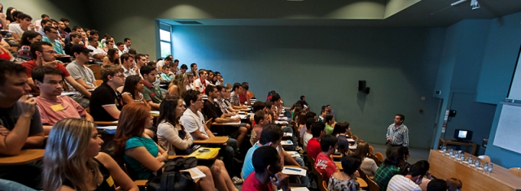
The class as a theatrical play
1. Introduction
Theatre
Convey a story
Teaching
Convey knowledge

Slide 5
The class as a theatrical play
1. Introduction
Our aim: Combine both approaches and bring theatre to the classroom
Tell a well structured, captivating story and ensure that its level of attention is maintained through better timing, demonstrations and props
The challenge: How to so in an effective and systematic manner?

Slide 6
The class as a theatrical play
1. Introduction
Inspirations
Prof Raimundo Delgado (1950-2019)
Prof Richard Feynman (1918-1988)

Slide 7
The class as a theatrical play
1. Introduction
Classes can follow different formats
Story
format
Expositional
format
Here, telling a cohesive story is everything, with well defined parts and a rough chronological structural. We can use a classical theatrical play structure (three acts)
When we don’t really have a cohesive story to follow. Thus, we adopt techniques mostly used in speech writing and even stand-up acts
Notes:
Story → microstructure of materials
Expositional → anatomy class

Slide 8
The class as a theatrical play
1. Introduction
General considerations
Your opening statement is the most important one– Start the class by exposing the most important and challenging concept of the class
Your closing statement is the second most important one – Finish strongly, with a simple and easy to remember but poignant lesson
Your expressiveness sells the knowledge– Express yourself, communicate clearly and don’t be afraid to move
Notes:
Sense of humour

Slide 9
The class as a theatrical play
1. Introduction
General considerations
Punchlines and twists capture the attention – Create easy to remember punchlines to summarize important notions. Explore twists to challenge pre-existing notions
Never overextend the class – Respect the allotted time and the student’s attention span
The class is not only yours, bring the students into the discussion – Attempt to bring the students into the discussion in a constructive manner. Don’t try to show them they are wrong but encourage them to seek solutions
Notes:
Esse processo foi descoberto por Charles Goodyear (1800-1860) em 1838. Ele percebeu que uma mistura de borracha e enxofre que caiu sobre o fogão quente não chegou a derreter, mas apenas queimou um pouco. Com isso, ele percebeu que com a adição de enxofre, a borracha tornava-se mais resistente. Foi o próprio Goodyear que deu o nome para esse processo de vulcanização, em homenagem ao deus grego do fogo, Vulcano.

Slide 10
The class as a theatrical play
1. Introduction
Props and demos
Props and demos should be used often, but not constantly
Select demos and props which are the simplest, most understandable object that represents the concept at hand
However, they should be rememberable and remarkable
Encourage the students to handle them, to test them
Prof Walter Lewin (MIT, USA)
Notes:
Walter Lewin
The simple gravity pendulum^{[4]} is an idealized mathematical model of a pendulum.^{[5][6][7]} This is a weight (or bob) on the end of a massless cord suspended from a pivot, without friction. When given an initial push, it will swing back and forth at a constant amplitude. Real pendulums are subject to friction and air drag, so the amplitude of their swings declines.

Slide 11
The class as a theatrical play
2. Methodology

Slide 12
The class as a theatrical play
2. Methodology
1. Analyse the knowledge that should be conveyed to the students and modify the classes to improve communication
2. Create support material and demos to enrich the classes
3. Prepare a practical guide to support other teachers undertaking in similar activities
4. Assess the impact of these activities through interviews and surveys

Slide 13
The class as a theatrical play
3. Implementation

Slide 14
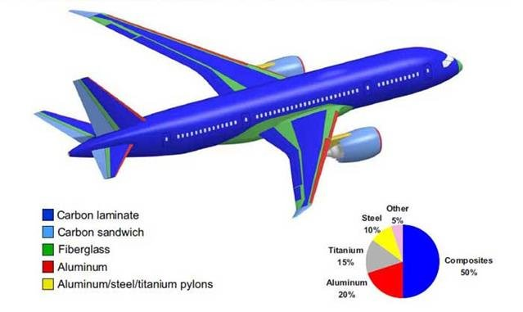
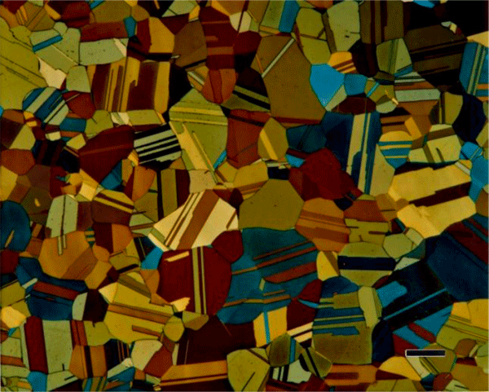
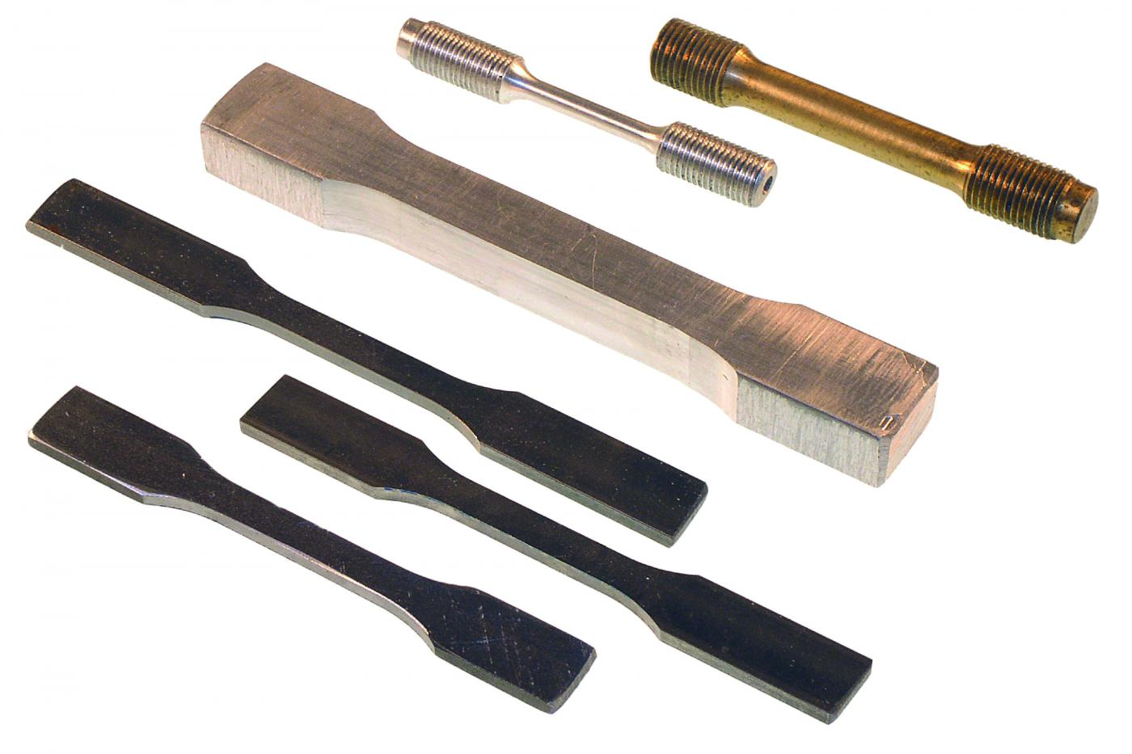
The class as a theatrical play
3. Implementation – Course
Target course: “Materials”
1st year of the Bachelor in Management and Industrial Engineering
Acquisition of knowledge about the mechanical behavior of materials and about the main groups of materials
Presentation of concepts and basic general information, examples and typical cases of materials and their applications.
Demonstration of tests for material characterization in laboratory and study visits.

Slide 15
The class as a theatrical play
3. Implementation – Communication
Before:
Theoretical-practical classes
Practical classes
Live classes
Exercise solving

Slide 16
The class as a theatrical play
3. Implementation – Communication
After:
Theoretical-practical classes
Practical classes
Live classes
Exercise solving
Pre-recorded classes
Demos
Laboratorial activities
Masterclasses

Slide 17
The class as a theatrical play
3. Implementation – Support material
Pre-recorded classes
Easily accessible resource for conveying the “knowledge heavy” portions of syllabus
Free the live classes from the pressure of delivering all this information

Slide 18
The class as a theatrical play
3. Implementation – Support material
Laboratorial demos and props
Allow for hands-on learning with easy to understand examples
Well-thought laboratorial demonstrations permit the quick memorization of key principles and findings

Slide 19
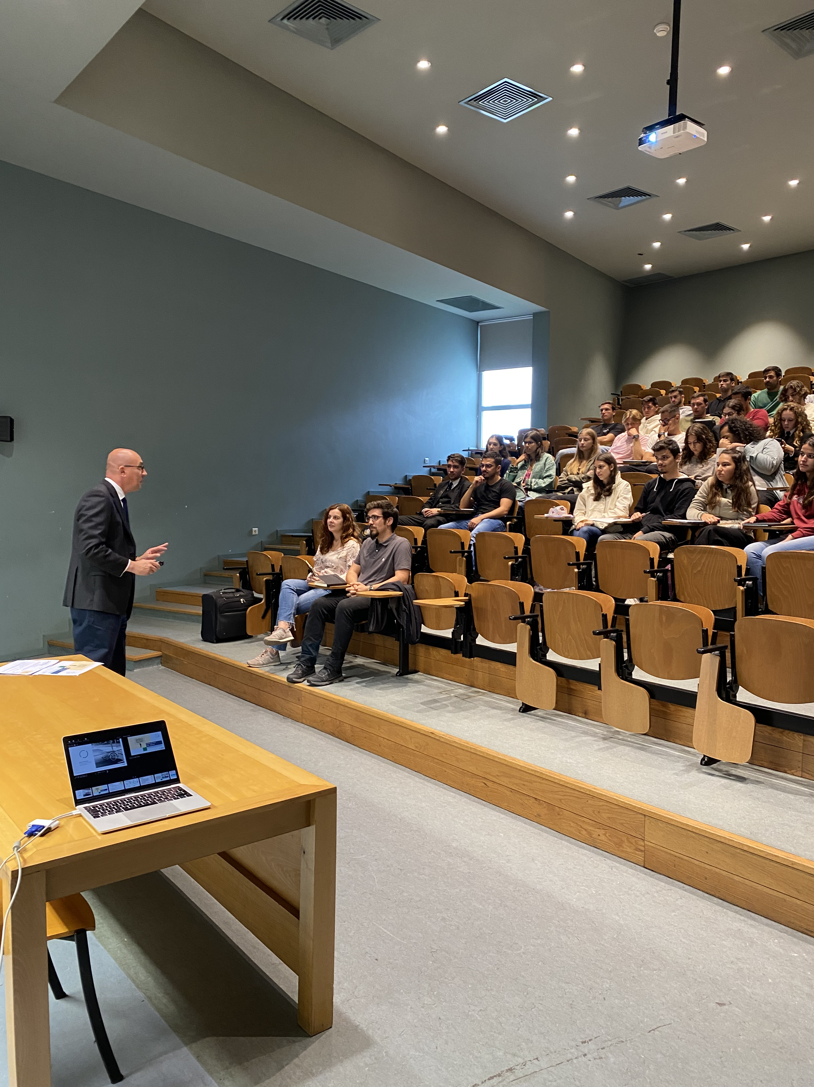
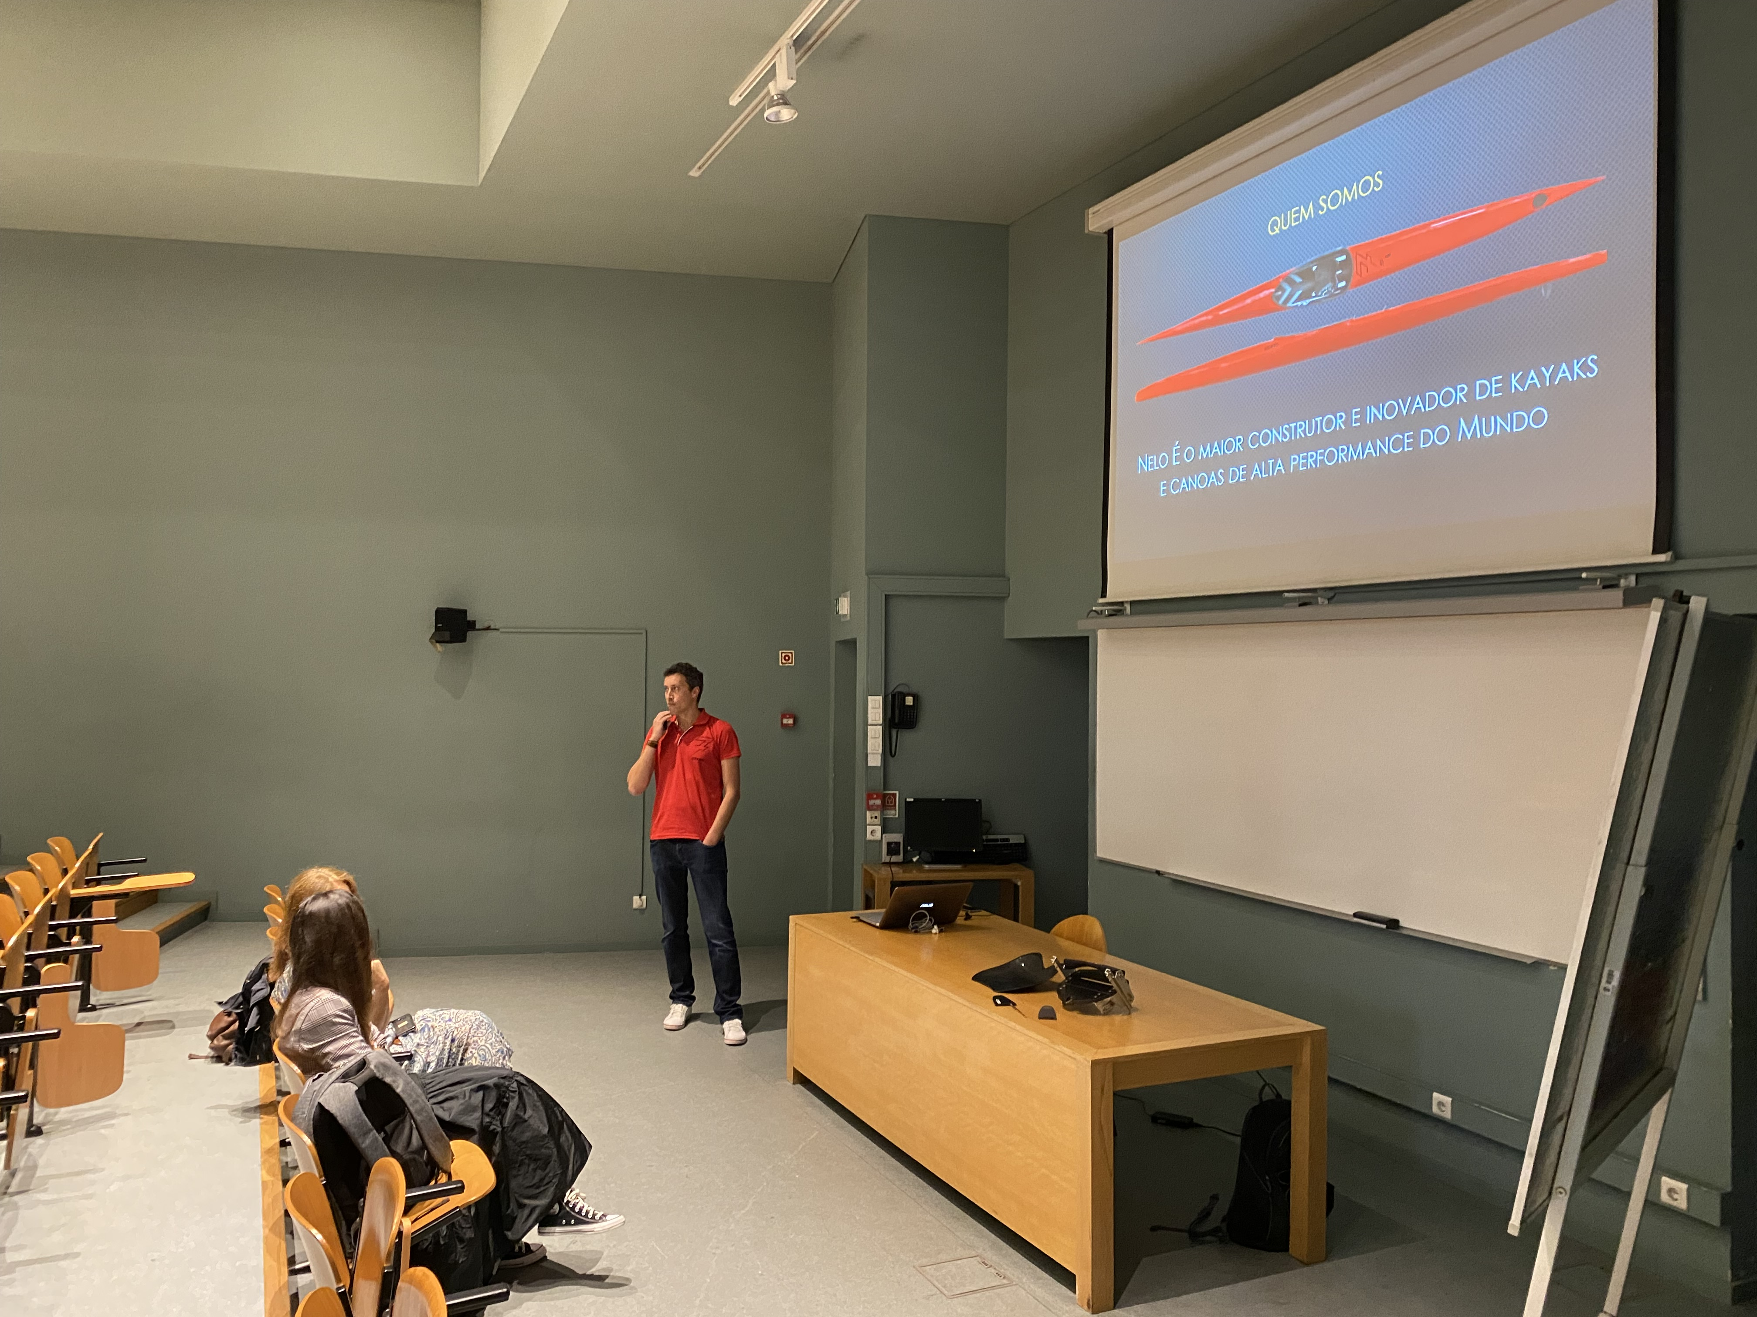
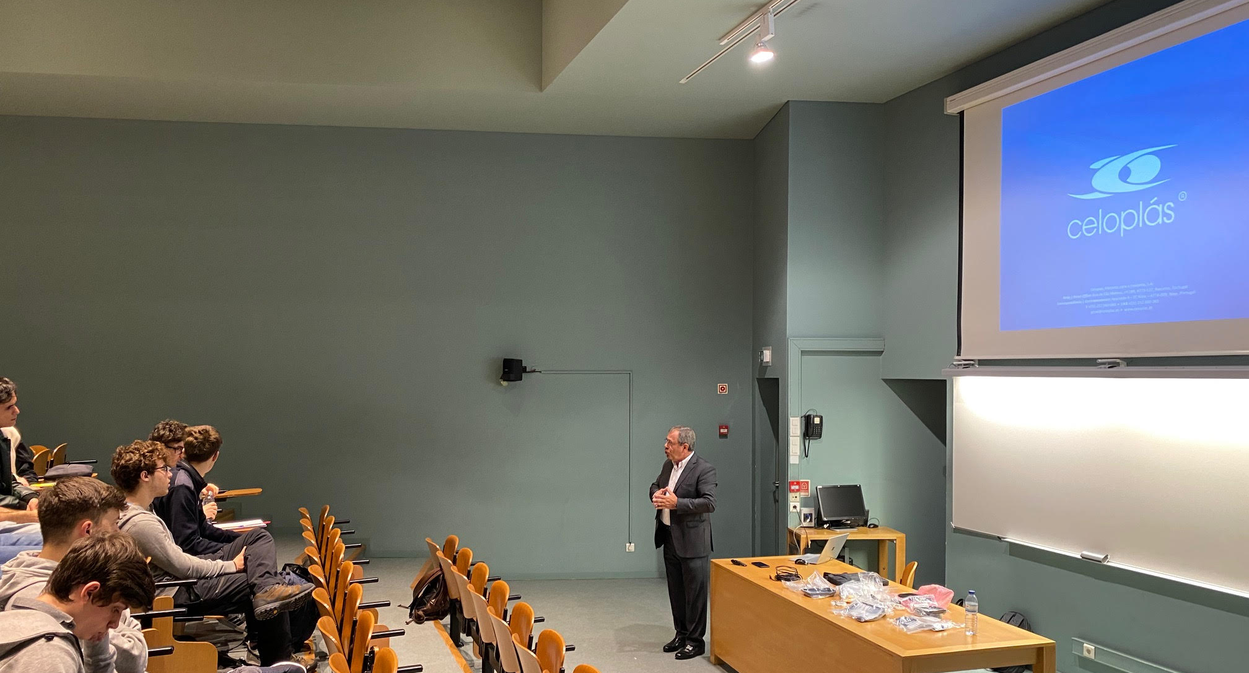
The class as a theatrical play
3. Implementation – Communication
Masterclasses
Industry experts and leaders (SEG, NELO, CELOPLAS, etc.) called to provide their hands-on experience
Effort is made to relate this experience with the course syllabus

Slide 20
The class as a theatrical play
4. Practical guide

Slide 21
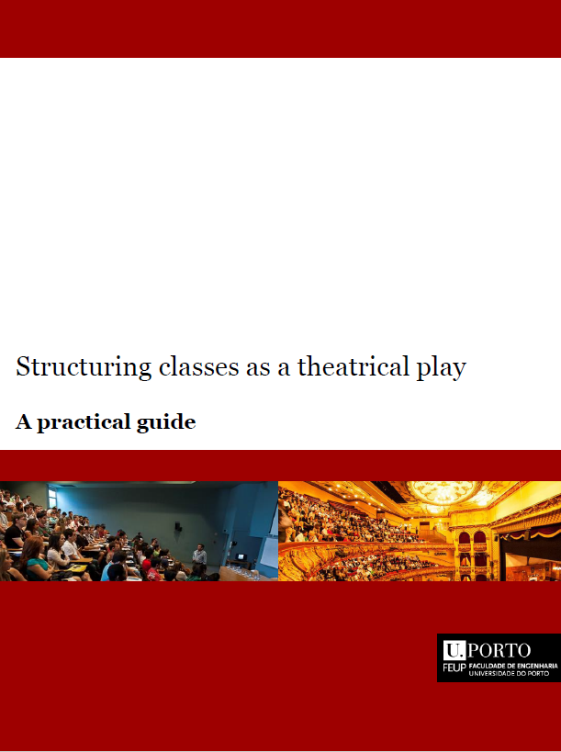
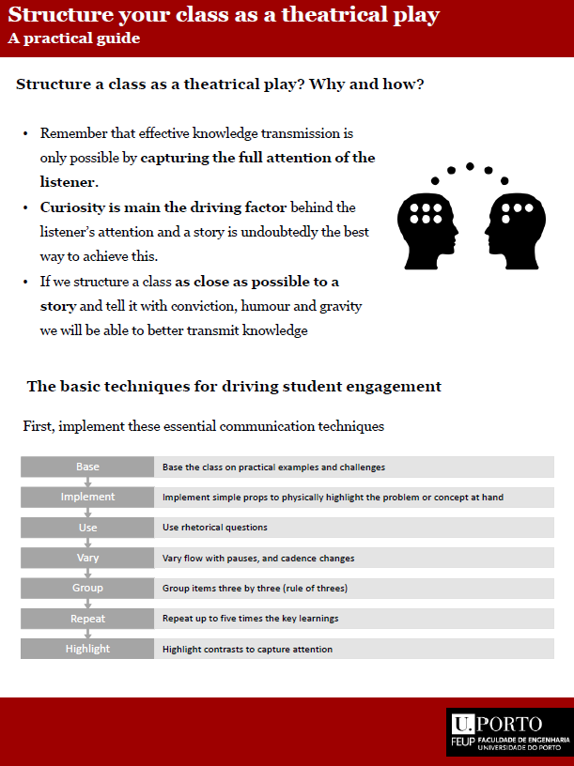
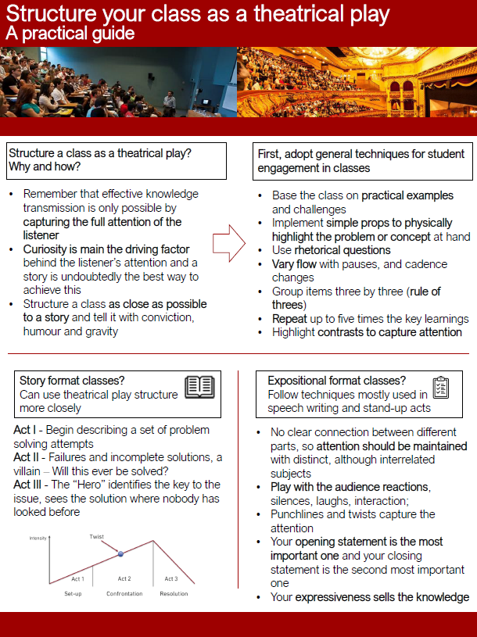
The class as a theatrical play
4. Practical guide

Slide 22
The class as a theatrical play
5. Assessment

Slide 23
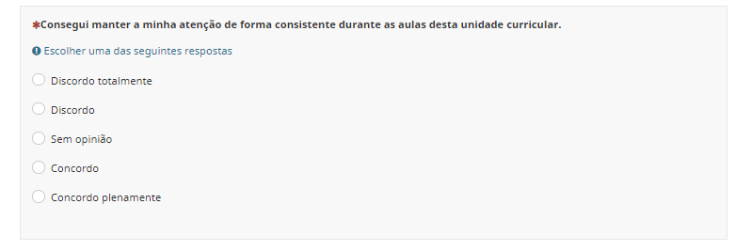
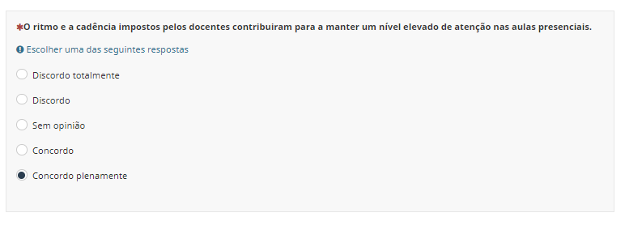
The class as a theatrical play
5. Assessment - Survey
Survey of the students
Online survey
10 questions
Interest in subject
Impact on the classes and personal preference
Outlook on cadence, props and masterclasses
Answer rate 34% (44 full replies)

Slide 24
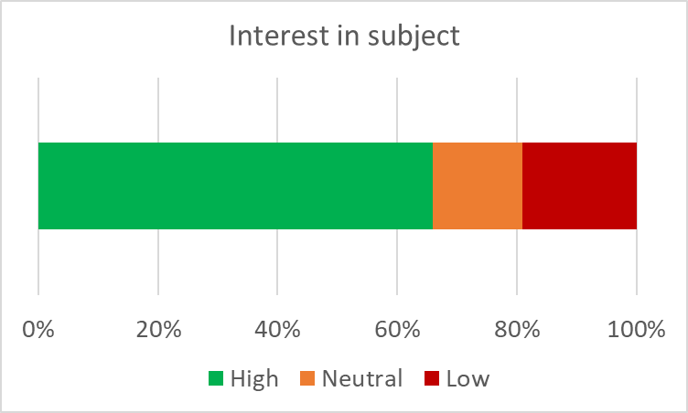
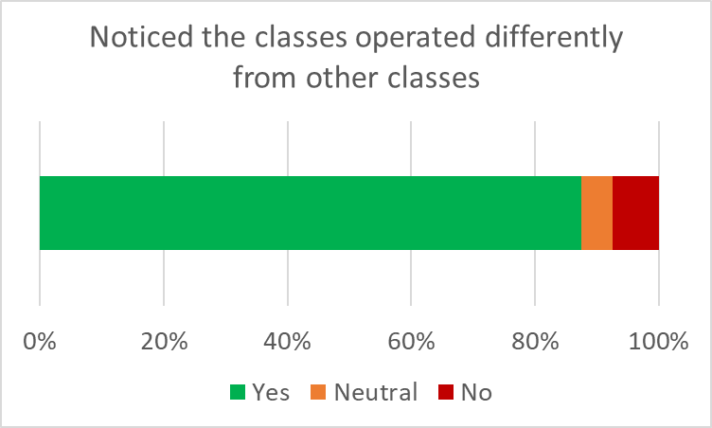
The class as a theatrical play
5. Assessment - Survey
Positive outlooks

Slide 25
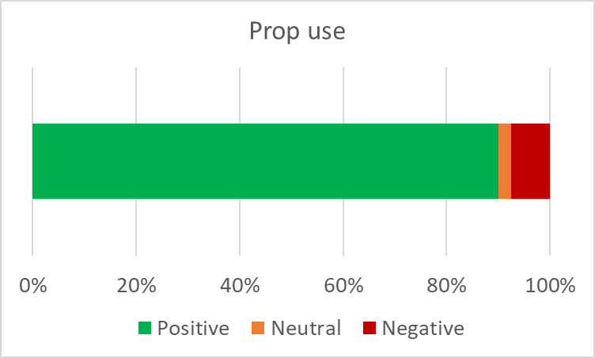
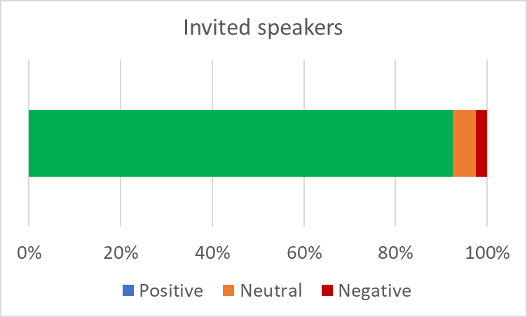
The class as a theatrical play
5. Assessment - Survey
Positive outlooks

Slide 26
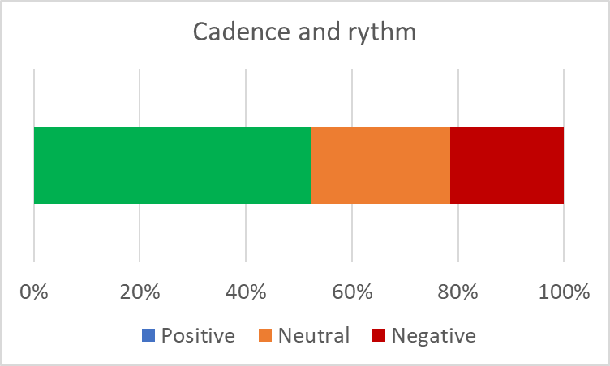
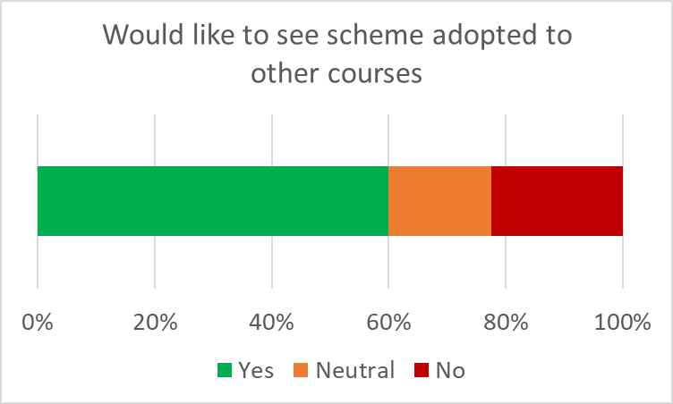
The class as a theatrical play
5. Assessment - Survey
Less positive outlooks

Slide 27
The class as a theatrical play
5. Assessment - Interview
Interviews with students
8 volunteer students interviewed by someone external to the course
Opinion on the videos. Were they useful?
Opinion on contents of the T/P classes
Were the classes noticeably modified to account for the videos?
Was it easier to maintain focus during these classes?
How do you rate your level of knowledge acquisition against other courses?
Would you like to see this employed in other courses?

Slide 28
The class as a theatrical play
5. Assessment - Interview
Positive outlooks
Support videos were reported as a powerful tool for studying
Most accepted positively trade-off between time and content
Majority reports that it was much easier to remain focused than other courses
Students believe that many courses could benefit from this approach

Slide 29
The class as a theatrical play
5. Assessment - Interview
Less positive outlooks
Some report that once they failed to follow the videos timely, they became lost in some of the classes
Volume of information was always reported as the main challenge, since it is a lot to memorize

Slide 30
The class as a theatrical play
5. Assessment - Interview
Implementation in other courses?
All report that it could not work for Math courses
Would work very well for Economics courses, since Videos and Masterclasses will fit perfectly with the subject
All courses operating like this would not work, since watching the videos properly requires a lot of time (1.5x times the video length)

Slide 31
The class as a theatrical play
6. Conclusions

Slide 32
The class as a theatrical play
6. Conclusions
Main findings
Restructuring of the course into different types of classes allowed to improve the pacing of knowledge transfer
Use of support videos was very welcomed by the students, although it cannot be adopted by all courses
Masterclasses were highly appreciated, providing a connection with industry
Students had a mostly positive outlook on the change, and suggest the implementation of this format into other courses

Slide 33
Lucas F. M. da Silva
lucas@fe.up.pt

